Slide 1
Network Signaling (SS7)
Introduction
Architecture
Performance
Advantages
Multiple Access Techniques
By Jasleen Kaur
IT Dept.
GTBIT

Slide 2
Introduction
The SS7 signaling protocol is widely used for common channel signaling between interconnected networks.
SS7 is used to interconnect most of the cellular MSC’s & is the key factor in enabling autonomous registration and automated roaming in first generation cellular systems.

Slide 3
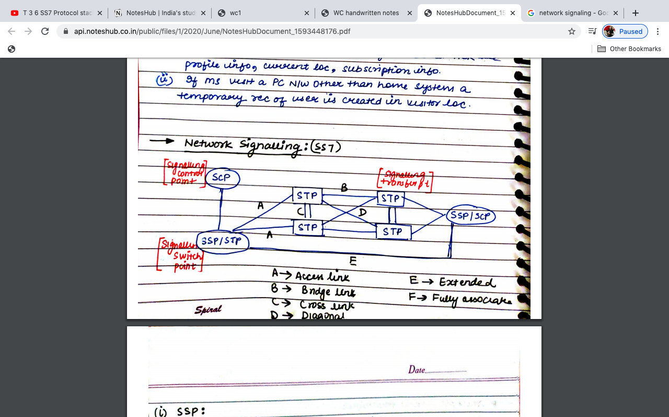
Network Signaling SS7

Slide 4
SSP(Signaling Switching Point)
It is an interface to telephone network.
It convert voice signal to SS7 signal link.
Local exchange to subscriber.
SCP (Signaling Control Point)
It is an interface between Database (HLR,VLR)
Handles database queries & subscriber information.
STP(Signaling Transfer Point)
It is basically a network node.
Works as a router.

Slide 5
A Link: connects SCP/STP to SSP and provides information about subscriber.
B Link: connects STP to STP.
C link: connects STP=STP only works for route failure and in that case provide another part.
D link: connects STP-STP diagonally.

Slide 6
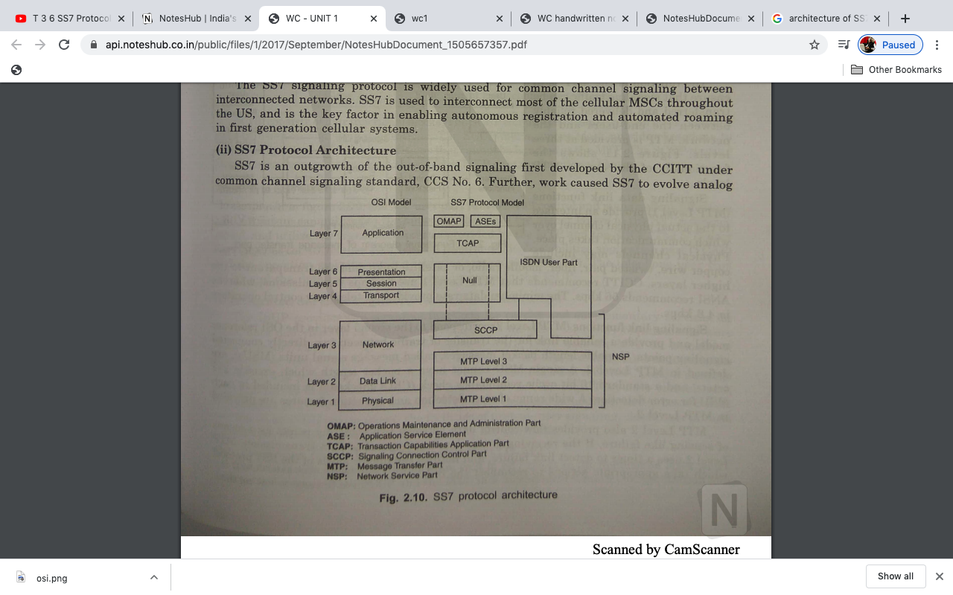
SS7 Protocol Architecture

Slide 7
The SS7 uses, a four layer protocol stack.
These protocol provide different services, depending on the use of, the signaling network.
The Bottom three layers are meant for communication and transmission of message. These three levels are referred to the Message Transfer Part (MTP).
MTP provides the reliable service for routing messages through the SS7network.
The upper portion or the fourth layer of the stack, performs the data processing function.

Slide 8
Network Service Part (NSP): provides ISDN nodes with a highly reliable and efficient means of exchanging signaling traffic using connectionless services.
Message Transfer Part (MTP): The MTP provides reliable service for routing messages. The MTP is divided into three levels:
MTP level1: is the lowest level. MTP1 is the physical layer.
It is an interface to actual physical channel.
It moves bits and bytes, over electrical and data paths.
It uses time slot of a 2Mbps.
MTP level2: Equivalent to data link layer in OSI.
MTP-2 provide support to MTP-3 in link management by ensuring accurate end to end transmission of a message,

Slide 9
By performing error detection.
Arranging of retransmission.
Implementing flow control,.
By delivering the message in sequence to users.
Detecting and declaring faulty link conditions.
MTP level3:
Provides message routing between signaling points in SS7 network.
It ensures that the message can be delivered between signaling points, across the SS7 network irrespective of whether they are directly connected or not.
MTP3 reroutes traffic, away from failed links and signaling points. MTP3 also control traffic, when congestion occurs.
Provides nodes addressing, routing and alternate routing.

Slide 10
User Part: is known as level4 in the layered structure of the signaling system.
It includes the message, message coding and the protocol necessary, to support telephony and ISDN.
This consists of the processes for handling the services being supported by the signaling system.
The message transfer part, is capable of, supporting many different user parts.
The SS7 user part includes the ISDN user part (ISUP), the transaction capabilities application part (TCAP), and the operation maintenance and administration part (OMAP). The telephone user part(TUP) and the data user part(DUP) are included in ISUP.

Slide 11
Integrated Services Digital Network User Part (ISUP): provides signaling functions for carrier and supplementary services for voice, data and video in an ISDN environment.
Transaction Capabilities Application Part(TCAP) refers to the application layer which invokes the services of SCCP and the MTP in a hierarchical format and is concerned with remote operations.
Operation Maintenance And Administration Part(OMAP): include monitoring, coordination and control function to ensure that trouble free communications are possible.
Signaling Connection Control Part(SCCP): can address applications, within a signaling point.

Slide 12
Performance of SS7:
The performance of Signaling network is studied by the connection set-up time(response time) or end to end signaling information transfer time.
Advantages of Common Channel Signaling over Conventional Signaling:
Faster call set-up: In CCS, high speed signaling networks are used for transferring the call set-up messages resulting in smaller delay times compared to conventional signaling.
Greater Trunking (or Queuing) Efficiency: CCS has shorter call set-up and tear down times that results in less call- holding time, reducing the traffic on the network.
Information Transfer: CCS allows the transfer of additional information along with the signaling traffic providing facilities such as caller identification and voice or data identification.

Slide 13
A Basic Cellular System
A wireless radio network covering a set of cells in which two way radio units such as cellular or PCS telephones, can communicate.
The radio network is defines by a set of Base station which serves as central control for all users within that cell.
Mobile users can communicate directly with the base stations and base station directly with Mobile Telephone Switching Office(MTSO) or MSC.
An MTSO controls channel assignment, call processing, call setup and call termination which include signaling switching, supervision , and allocating radio- frequency channel.
MTSO provides a centralized administration and maintenance point for the entire network.

Slide 14
Base station can improve the transmission quality, but they cannot increase the channel capacity within the fixed bandwidth of the network.
Base station are distributed over the area of system coverage and are managed and controlled by an on-site computerized cell site controller that handles all cell-site control and switching function.
The function of Base station is to provide an interface between mobile telephone sets and the MTSO. BS communicate with the MTSO over dedicated data links.

Slide 15
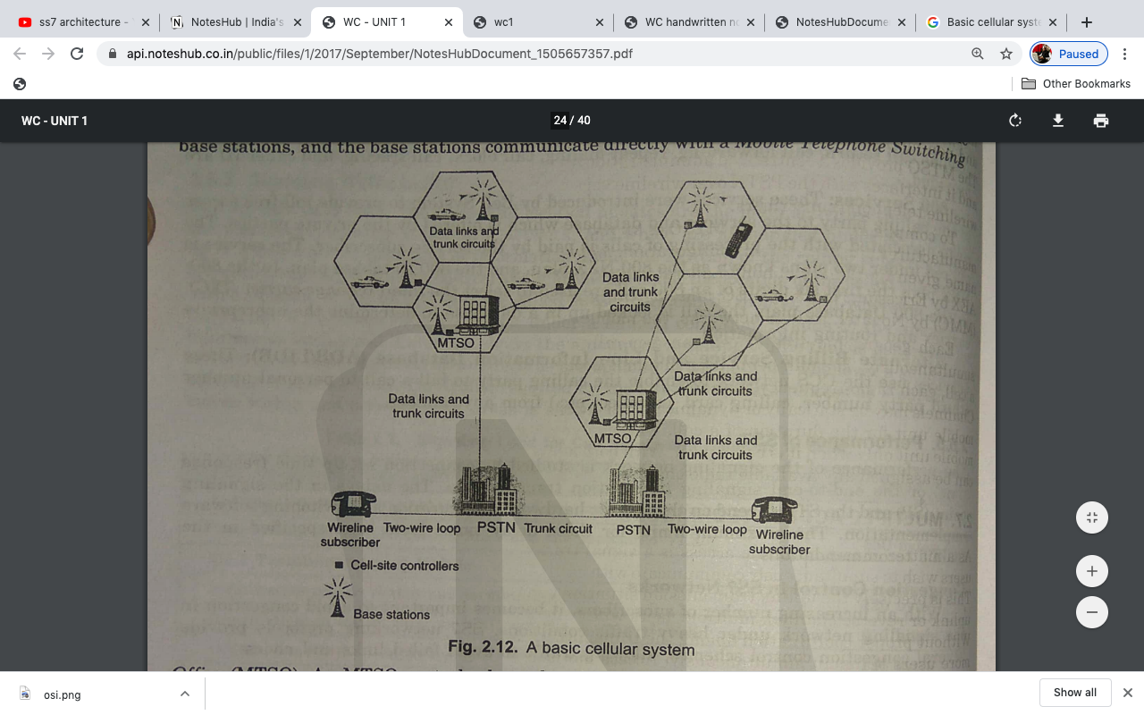

Slide 16
Multiple Access Techniques
Multiple access is a signal transmission situation in which two or more users wish to simultaneously communicate with each other using the same propagation channel.
It is often desirable to allow subscriber to send information simultaneously from MS to BS while receiving information from BS to MS.
The main aim is able to increase the capacity of channel as possible in given bandwidth with sufficient quality of service.
Multiple Access Schemes are:
Frequency Division Multiple Access(FDMA)
Time Division Multiple Access(TDMA)
Code Division Multiple Access(CDMA)
Space Division Multiple Access(SDMA)

Slide 17
FDMA :
Individual user are allotted individual channels. The channels are frequency band is unique for each user/subscriber. Or
In this scheme the avail bandwidth is divided into various frequency band.
Each station allocated a band to end its data when service request is made.
Thus each band is reserved for specific station and no other user can share the same frequency band.
Guard Band; In each band there is a guard band which unable the overlapping or we can say to avoid frequency overlapping small gap in the frequency band are required, those are called guard band.
Used for FDD (Frequency Division Duplexing).
Bidirectional communication is possible simultaneously and is essential for cellular communication also. Such a simultaneously talk and listen facility is known as Duplexing. Under frequency division multiplexing, duplexing is done using frequency & termed as FDD.

Slide 18
Salient feature of FDMA:
FDMA requires proper filtering at receiver side to avoid adjacent channel interference.
In FDMA scheme, if a channel is not in use it will be idle and it will not be used by some other user.
FDMA channel can handle one phone circuit at a time.
Complexity is less.
If voice channel are assigned in FDMA , then, the mobile unit and base station start transmitting simultaneously.

Slide 19
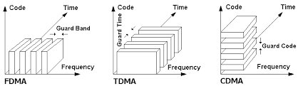

Slide 20
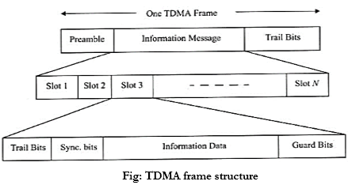
2) TDMA :
In time division duplexing (TDD) utilizes time instead of frequency.
Each TDD channel has individual time slots for forward and reverse time slots to have bidirectional communication.
All sender use same frequency at different point of time.

Slide 21
In TDMA system the entire radio spectrum is divided into time slots where a single user is allowed to use the radio channel in a time slot.
In this format the preamble field contains the synchronization and address information. The guard bits are used to allow synchronization of different receiver between various frames and time slots. There are ‘N’ number of time slots for ‘N’ number of users.
Salient feature of TDMA:
Each user in TDMA multiple access scheme shares same carrier frequency but with non overlapping time slots.

Slide 22
3) CDMA:
In CDMA technique any users share the same carrier frequency.
The narrow band signal is also multiplexed with a spreading signal of larger bandwidth. This spreading signal is actually a pseudo noise code sequence.
Spread Spectrum technology ,as it allow many users to occupy the same time and frequency in a given band/space.
Each user /subscriber is allocated n individual pseudo random codeword that is orthogonal all other codewords of remaining users.

Slide 23
Salient feature of CDMA:
CDMA has a better soft capacity limit than TDMA and FDMA.
CDMA has less interference problems due to allocation of unique codes to each user and multiple access technique is applied for defence areas than other multiple access technique.
Radio signal strength indicator(RSSI) is being used n CDMA to have better power control.
Handoff is very well handled.
Recommended for voice and data communication.
Every user use full available spectrum.

Slide 24
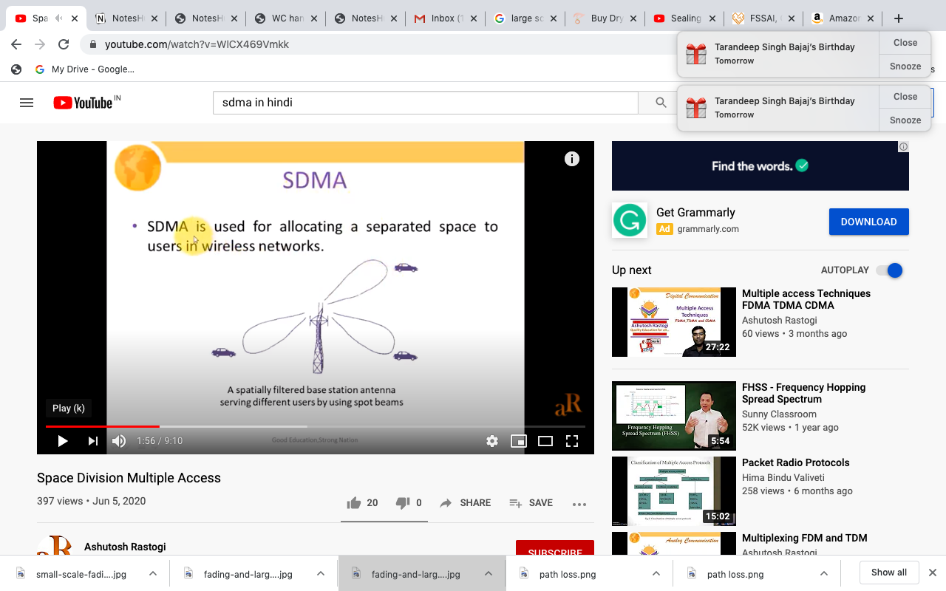
SDMA:
SDMA is capable of controlling radiated energy for each and every user in space, i.e. by spot beams a spatially filtered base station antenna serves different cellular users.
SDMA is used for allocating a separated space to users in wireless network.

Slide 25
SDMA serves different users by using spot beam antennas.
A typical application involves assigning an optimal base station to a mobile phone user.
Typically SDMA is never used in isolation but always in combination with one or more schemes such as FDMA, TDMA or CDMA.
Problems with SDMA:
Reverse link presents the difficulty in cellular system.
Different propagation path exists from user to the base station.

Slide 26
